Slide 1

Session IV: Agricultural commodities price volatility and food security
Long-Term Lessons from Short-term Volatility
Amar Bhattacharya
G24 Secretariat
G-20 Conference on Commodity Price Volatility, Istanbul, 12-13 September 2011

Slide 2
Outline
Differential Impacts of agricultural price developments
Addressing and coping with short-term volatility
Long-term imperative to revitalize agriculture

Slide 3
1. Differential Impacts of Agricultural Price Developments

Slide 4
Long Term Nominal and Real Agricultural Prices
Source: World Bank, PINK data.

Slide 5
Variation in Nominal Commodity Prices Across Product Groups
Nominal commodity prices
Base 100=2000
 | Energy | Agriculturals | Beverages | Food | Raw Materials | Metals & Minerals
Average values
1960-1969 | 5.00 | 50.50 | 55.98 | 52.55 | 42.74 | 42.30
1970-1979 | 34.28 | 101.15 | 151.69 | 106.00 | 63.68 | 68.55
1980-1989 | 90.35 | 124.93 | 183.88 | 124.54 | 95.89 | 98.87
1990-1999 | 66.75 | 126.38 | 136.52 | 126.57 | 120.75 | 106.92
2000-2009 | 172.65 | 144.29 | 143.28 | 148.77 | 133.90 | 186.67
2010 | 271.17 | 231.33 | 253.76 | 224.11 | 237.48 | 337.19
Historical peak | 341.97 | 231.33 | 322.28 | 247.41 | 237.48 | 339.13
 | 2008 | 2010 | 1977 | 2008 | 2010 | 2007
Historical minimum | 4.56 | 48.12 | 50.16 | 47.23 | 37.65 | 33.35
 | 1969 | 1962 | 1965 | 1960 | 1971 | 1962
Source: World Bank, PINK data.

Slide 6
Why Differential Impact?
Differences in endowments and production patterns
Differences in consumption patterns
Impact of domestic policies

Slide 7
Net-Exporters and Net-Importers Across Selected Product Categories
Product Category | Income grouping | Number of Net-Exporters | Number of Net-Importers
Agricultural | High-income countries Middle-income countries Low-income countries | 16 39 15 | 32 56 24
All food items | High-income countries Middle-income countries Low-income countries | 14 38 10 | 34 59 30
Basic food (excl. beverages) | High-income countries Middle-income countries Low-income countries | 14 32 2 | 34 65 38
Agricultural raw materials | High-income countries Middle-income countries Low-income countries | 16 35 28 | 32 61 12
Beverage Crops | High-income countries Middle-income countries Low-income countries | 15 24 5 | 33 70 35
Note: The sample consists of 48 high-income countries, 97 middle-income countries and 40 low-income countries

Slide 8
Figure 1: Largest Net Exporters and Net Importers: “All Agriculture” (in US$ Billion) HICs

Slide 9
Figure 1: Largest Net Exporters and Net Importers: “All Agriculture” (in US$ Billion) MICs

Slide 10
Figure 1: Largest Net Exporters and Net Importers: “All Agriculture” (in US$ Billion) LICs

Slide 11
All Agricultural Exports: HICs
US$ billion

Slide 12
All Agricultural Exports: MICs
US$ billion

Slide 13
All Agricultural Exports: LICs
US$ billion

Slide 14
2. Addressing and Coping with Short-Term Volatility

Slide 15
Agreement on Some Steps
Establish Agricultural Market Information System (AMIS)
Improve information and transparency in futures and OTC derivatives markets
Improve risk management tools
Emergency food reserves for humanitarian assistance with free access
Rebuild stocks but costly
Targeted social safety nets with focus on nutrition
Countercyclical financing from IMF and MDBs
Improved interntional coordination

Slide 16
Less on Others
Limits on positions or other direct regulations in futures markets
International buffer stocks
Change biofuels policy
Divert grain from biofuels or feed during spikes

Slide 17
2. Long-Term Imperative to Revitalize Agriculture

Slide 18
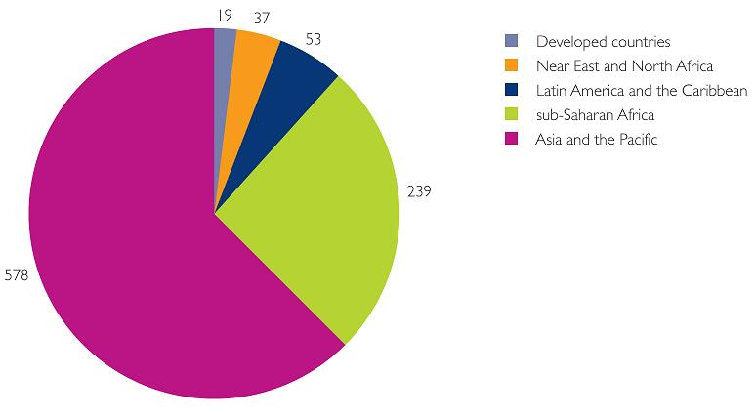
Hunger
World Hungry
30%
~1B hungry, most in Africa and Asia
Unlikely to meet MDG 1
1
20%
Billion
½
10%
8%
Hunger
2010
1970
1985
2000
2015
Rest of the
World
Physical, economic & social access to food
Non-food system causes
“Hidden hunger” (~1B)
“Over-nourished” (~1B)
Africa
Asia & Pacific
Source: FAO (2010)
Notes:
18
18

Slide 19
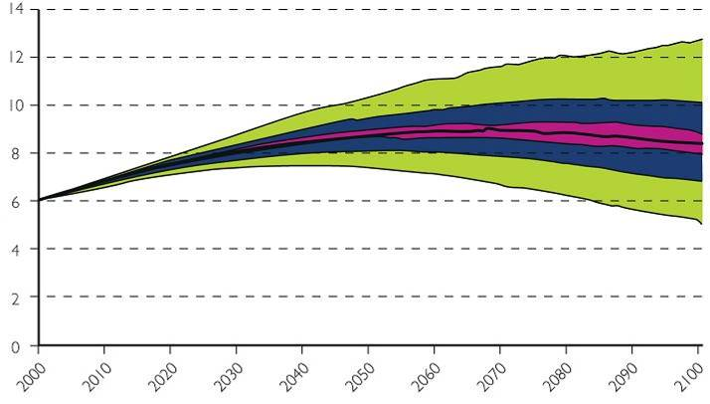
Increasing demand
Population projection (Lutz & Samir 2010)
95%
12B
60%
Population most likely to peak ~9B
20%
8B
4B
Livestock consumption (FAO 2009)
2000
2050
2100
Developed nations
China
Livestock consumption
People will be richer and demand higher quality diet
India
Africa
1970
1980
1990
2000
Notes:
19
19

Slide 20
Current Agricultural Production System
Not Sustainable
Degradation—24 percent of agricultural land degraded
Depletion of forests and over-exploitation of fisheries
70 percent of global water use
Nitrogen and other pollutants
30 percent of GHG emissions come directly or indirectly from agriculture
Growing constraints on land, water, energy and marine resources

Slide 21
Impact of and Adapting to Climate Change
Even with 2 degree mean rise in temperature impact on agricultural output could be 20-30 percent in South Asia and Africa
Significant probability of greater increase with unknown impacts
Will require large physical and technological investments

Slide 22
A Big Push to Revitalize and Reform Agriculture
Significant scope for increasing yields on basis of existing technologies
Scope and need for adopting best practices including with respect to sustainable farming
Invest in new technology including in adaptive technologies and in capacity building through coordinated global effort (CGIAR, FAO)

Slide 23
A Big Push to Revitalize and Reform Agriculture
Large scale private and SOE investments can raise production and productivity of agriculture especially in low income countries
But need for transparency and compliance with good practices.
Principles for Responsible Agriculture Investments.
Main challenge is to revamp public investment at the global, regional and national levels targeted to smallholder agriculture learning lessons from the past.

Slide 24
A Big Push to Revitalize and Reform Agriculture
Globally coherent biofuels policies
Reach agreement on a development oriented outcome of the Doha Round. Centerpiece must be the abandonment of trade distorting domestic support, reduction of export subsidies and improved market access by advanced economies.
Case for transitory safeguards and support especially in low income countries although increases in prices will reduce the need for such protection
Domestic regulatory reform
Curb Waste

Slide 25
Incremental Financing Needs
Are Large
($ billion)
 | MDGs + | Agriculture/ Food Security | Infrastructure | Climate
Low Income | 50-100 | 50-100 | 100-150 | 100-150
Emerging Markets | 200-300 | 150-200 | 700-800 | 200-400
Source: G24 Secretariat estimates

Slide 26

Thank you

